Slide 1
Random Forests and Resampling Methods
Dalton Hall

Slide 2
Topics
Random Forest
Definition
History
Methodology
Interpretation
Other Uses
Random Forest Demo
Resampling Methods
Cross-Validation
K-Folds CV
LOOCV
LGOCV
Bootstrap
Bootstrapping
Bagging and OOB
Resampling demo

Slide 3
Random Forest - Definition
Random forest is an ensemble learning method for classification or regression.
Random forests are constructed by training a specified number of decision trees.
The decision trees then “vote” and output either the mode of the classes selected by the trees (Classification) or the mean predicted value of the individual trees (Regression).
Random forest are designed to correct the habit of decision trees overfitting the data.

Slide 4
Random Forest - History
First algorithm for random forest was developed by Tin Kam Ho in 1995.
Introduced the idea of training an ensemble of trees using the random subspace method.
The algorithm was further developed by Leo Breiman and Adele Cutler
Breiman and Culter combined Tin Kam Ho’s ensemble of trees method with Breiman’s bagging method (we will define bagging later).
Fun Fact: Breiman and Cutler to this day still own the trademark to “Random Forest”, “Random Forests”, “RF”, “RandomForest”, and “RandomForests”.

Slide 5
Random Forest – Methodology
If the number of cases in the training set is N, sample N cases at random - but with replacement, from the original data. This sample will be the training set for growing the tree.
If there are M input variables, a number m<<M is specified such that at each node, m variables are selected at random out of the M and the best split on these m is used to split the node. The value of m is held constant during the forest growing.
Each tree is grown to the largest extent possible. There is no pruning.
When the training set for the current tree is drawn by sampling with replacement, about one-third of the cases are left out of the sample. This oob (out-of-bag) data is used to get a running unbiased estimate of the classification error as trees are added to the forest. It is also used to get estimates of variable importance.
(Breiman, Cutler 2004)

Slide 6
Random Forest - Interpretation
OOB Error Estimate
There is no need to use a validation or test set since the forest is constructed using repeated bootstrap sampling of the data. The estimate is an unbiased estimator of the forest’s accuracy.
Variable Importance
Variable importance is calculated by finding trees who correctly classified the data in both the “in-bag” and “out-of-bag” data. The variables are then tallied up and the in-bag and out-of-bag tallies are subtracted from one another. This value is then averaged over all variables.
Classification rates

Slide 7
Random Forest – Uses
Classification
Regression
Clustering
Missing Data Imputation
Variable Selection
Identifying Outliers

Slide 8
Random Forest Demo - R
The primary package for performing random forest analysis in R is randomForest.
Analysis can also be performed by using caret which is built on top of several analysis packages.
We will be using both in demos today.

Slide 9
Random Forest Demo - R
We will:
Install and load the correct libraries into our R Studio workspace.
Load and preprocess the data for analysis in R.
Classify the Ames housing data using the full data set, and a training and validation set.
Interpret our output

Slide 10
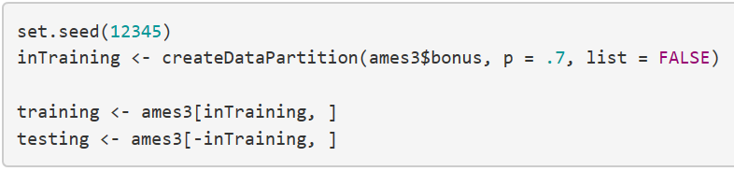
Random Forest Demo – Data Partition
New Variable
Function
Dataset $ target variable
Proportion in split
Rows containing the partition
Rows not containing the partition

Slide 11


Random Forest Demo – Optimization Grid
Function that creates a matrix of every possible combination of specified numbers
Variable we are iterating
Concatenate
“The number of columns in Ames minus one.” (The number of predictor columns)
“One through”

Slide 12
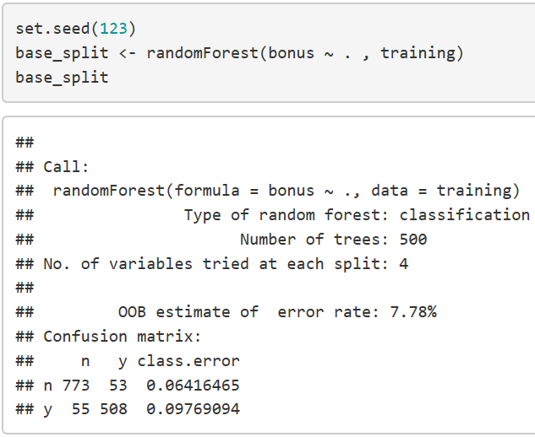

Random Forest Demo – Random Forest Code
Target variable
All other variables
Print output
Data set

Slide 14
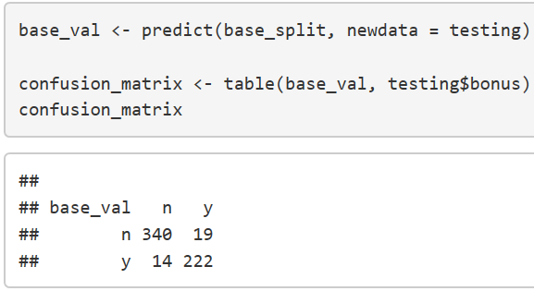
Random Forest Demo – Validation
Predict function
Using “base split” random forest
Data set were predicting

Slide 15
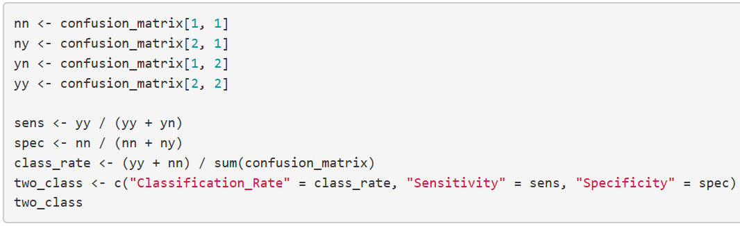
Random Forest Demo – Validation Cont.
Sensitivity
Specificity
Classification rate

Slide 16

Random Forest Demo – Validation Cont.

Slide 17
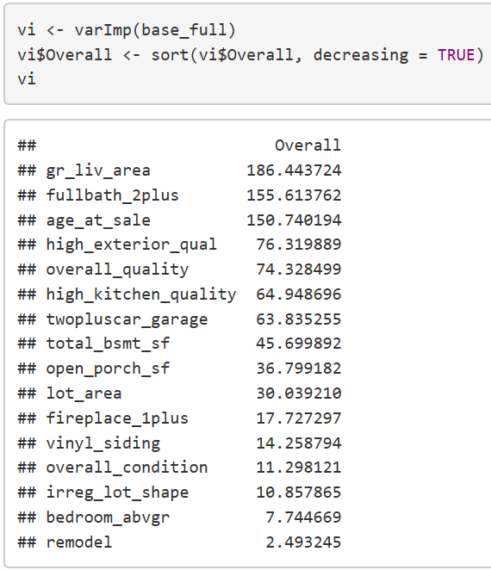
Random Forest Demo – Variable Importance
Variable importance function
Sort function
Sort on Overall, descending

Slide 18
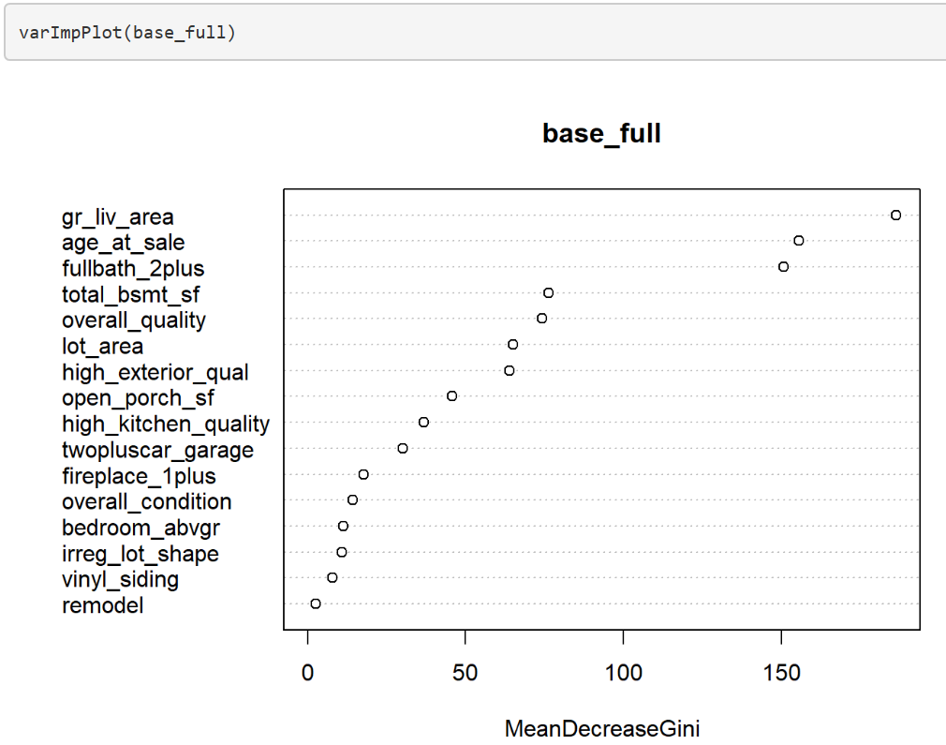

Slide 19
Resampling Methods – The Bias-Variance Trade-off
In supervised machine-learning, regression, and classification, modelers must choose the correct balance between bias and variance when selecting the correct model.
When a model is biased, it, but does not capture the underlying behavior of the data, and doesn’t normally perform well on a validation or test set of data. It is underfitting the data.
When a model has high error variance, it means there is a large difference between the error of the training and test data sets. It is overfitting the data.

Slide 20
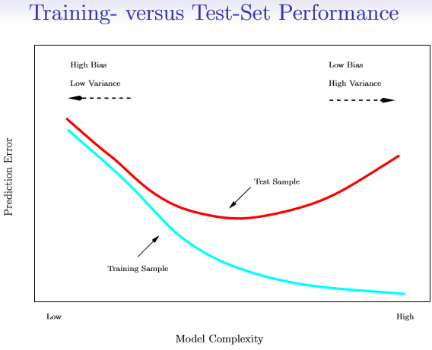

Slide 21
Resampling Methods – The Bias-Variance Trade-off
We use test data sets to try and find the optimum balance between bias and variance.
The best solution is to have a very large, independent data set that we could test our models on. This is normally not readily available, so we split our data sets into training and validation data sets to try and estimate this optimum.
For regression we look at the MSE and for classification we look at the misclassification rate to predict what the test error rate would be.

Slide 22
Resampling Methods
The draw backs to the validation set approach to estimating the test set is that the validation error rate can be highly variable and dependent on which observations are included in the training and validation sets.
This also limits the amount of information we use to train our models.
This suggests that the validation error estimate overestimates the test error rate compared to a model that used all the data.
Two commonly used methods to fix this are Bootstrapping and Cross-Validation.

Slide 23
Resampling Methods - Bootstrapping
Bootstrapping is a repeated sampling with replacement method primarily used when trying to estimate unbiased parameters and confidence intervals.
When bootstrapping, each sample is the same size as our original data set. This means that some observations will appear more than once in our data set.
This simulates the ability to get independent samples from the population data set (without really doing so).
General bootstrapping is not recommended for estimating prediction error as it likely underestimates error by using the same observations several times.

Slide 24
Resampling Methods - Bagging
Bagging (Bootstrap aggregating) is a machine learning method developed by Breiman (the inventor of random forest) where you bootstrap the sample every time your training method is iterated.
Bagging is typically performed on tree based methods but can be used in any ML method.
For each resample, the observations included in the bootstrap are treated as the training data, and the observations left out of the data are treated as the validation data. The unbiased estimate of the test error rate is then calculated as the average of the error rate of each “out of bag” sample.

Slide 25
Resampling Methods – Cross Validation
We will be covering two types of Cross Validation:
K-Folds Cross-Validation
Single
Repeated
Leave One Out CV
Monte-Carlo Cross-Validation
Leave Group Out CV

Slide 26
Resampling Methods – K-Folds CV
Steps:
Divide the data into K equally sized parts
Remove part k and train the data on the other remaining parts (K-1).
Test the trained model on part k.
Repeat for k = 1, 2, 3, …, K.
Combine results

Slide 27
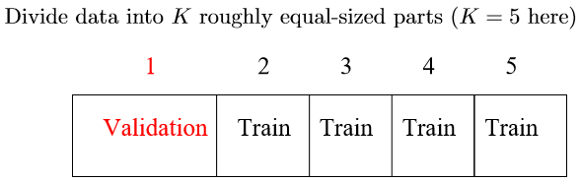
Resampling Methods – K-Folds CV

Slide 28
Resampling Methods – Repeated K-Folds CV
Repeated K-Folds does the same steps as K-Folds, but the steps are repeated a set number of times after being completed.
The observations selected in the each fold k are changed in each iteration, adding more flexibility to the model, and reducing bias.

Slide 29
Resampling Methods – LOOCV
Leave one out Cross-Validation is a special case of K-Folds where K is equal to the number of observations in the data set.
LOOCV minimizes bias but has higher variance.
LOOCV performs better when operating with smaller data sets.

Slide 30
Resampling Methods – Monte Carlo Cross-Validation
Monte Carlo Cross-Validation is also called Leave Group Out Cross-Validation (LGOCV).
This is the same as repeated split sampling. You set a proportion of the data you want to split into training and validation sets, and the number of times you want to resample.
LGOCV has more bias but less variance than the K-Fold methods.

Slide 31
Resampling Methods – Bias-Variance Spectrum
The Cross-Validation methods ranked in order of most biased to least biased are:
Split Sample
LGOCV
K-Folds
Repeated K-Folds
LOOCV
*Bootstrapping bias-variance ranges depend on the number of resamples, where bagging has the least bias.*

Slide 32
Resampling Methods – Things to Consider
Choosing the correct resampling method depends on the data itself.
The smaller the data set, the more biased the data set.
In this case, the bias needs to be corrected with a more complex resampling method:
E.G. if you data set has less than 50 observations, you should use LOOCV.
The larger your data set, the less biased the data set.
As number of observations approaches infinity, the simpler the optimal resampling method.
E.G. if your data set contains over 100,000 observations, split sample will estimate test error just as well as repeated K-Folds.
Choosing the correct resampling method also depends on the complexity of your model.

Slide 33
Resampling Methods Demo
We will:
Explain the process for running models in the Caret package.
Define our training control functions.
Define our models.
Compare models performance.

Slide 34
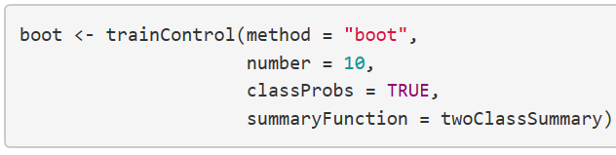
Resampling Methods Demo – Bootstrapping
Train control function
Bootstrapping
Number of resamples
Prior probabilities = True
ROC, Sensitivity, Specificity

Slide 35
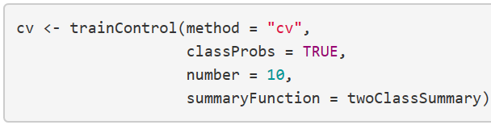
Resampling Methods Demo – K-Folds

Slide 36
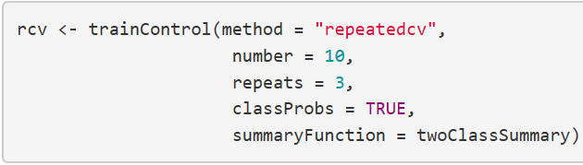
Resampling Methods Demo – Repeated K-Folds
Number of repeats

Slide 37
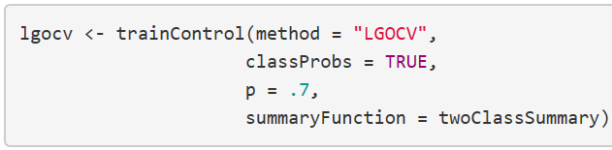
Resampling Methods Demo – LGOCV
Proportion in training groups

Slide 38
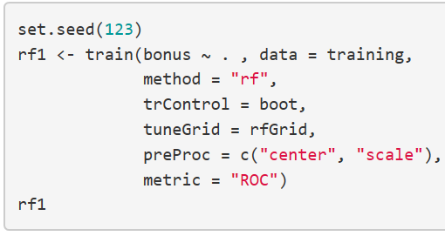
Resampling Methods Demo – Defining Model Example
Model
Data
Random Forest
Boot trainControl function we defined earlier
Print model
Optimization grid we defined earlier
Centering and scaling the data
Rank by ROC

